Slide 1

Infosys PYQ : Coding Questions
CODING QUESTION 01 / 02
1. Count all subsequences with sum K
Given an array nums and an integer k. Return the number of non-empty subsequences of nums such that the sum of all elements in the subsequence is equal to k.
EXAMPLES
Example 1:
Input : nums = [4, 9, 2, 5, 1] , k = 10
Output : 2
Explanation : The possible subsets with sum k are [9, 1] , [4, 5, 1].
Example 2:
Input : nums = [4, 2, 10, 5, 1, 3] , k = 5
Output : 3
Explanation : The possible subsets with sum k are [4, 1] , [2, 3] , [5].
CAMPUSMONK | CODING PRACTICE

Slide 2
Infofys PYQ : Coding Questions
EXPLANATION SPACE | AFTER QUESTION 01
Explanation: Count all subsequences with sum K
CAMPUSMONK | EXPLANATION SPACE

Slide 3
Infofys PYQ : Coding Questions
EXPLANATION SPACE | AFTER QUESTION 01
Explanation: Count all subsequences with sum K
CAMPUSMONK | EXPLANATION SPACE

Slide 4
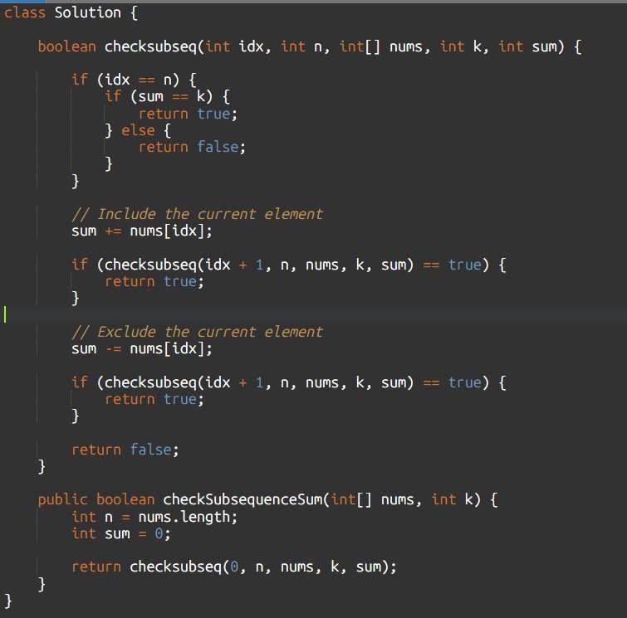
Infofys PYQ : Coding Questions
SOLUTION: JAVA
CAMPUSMONK | EXPLANATION SPACE

Slide 5
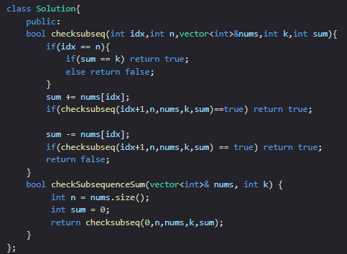
Infofys PYQ : Coding Questions
SOLUTION: CPP
CAMPUSMONK | EXPLANATION SPACE

Slide 6
Infofys PYQ : Coding Questions
CODING QUESTION 02 / 02
2. Generate Binary Strings Without Consecutive 1s
Given an integer n, return all binary strings of length n that do not contain consecutive 1s. Return the result in lexicographically increasing order.
A binary string is a string consisting only of characters '0' and '1'.
Example 1:
Input: n = 3
Output: ["000", "001", "010", "100", "101"]
Explanation: All strings are of length 3 and do not contain consecutive 1s.
Example 2:
Input: n = 2
Output: ["00", "01", "10"]
CAMPUSMONK | CODING PRACTICE

Slide 7
Infofys PYQ : Coding Questions
EXPLANATION SPACE | AFTER QUESTION 02
Explanation: Generate Binary Strings Without Consecutive 1s
CAMPUSMONK | EXPLANATION SPACE

Slide 8
Infofys PYQ : psuedo codes
EXPLANATION SPACE | AFTER QUESTION 02
Explanation: Generate Binary Strings Without Consecutive 1s
CAMPUSMONK | EXPLANATION SPACE

Slide 9
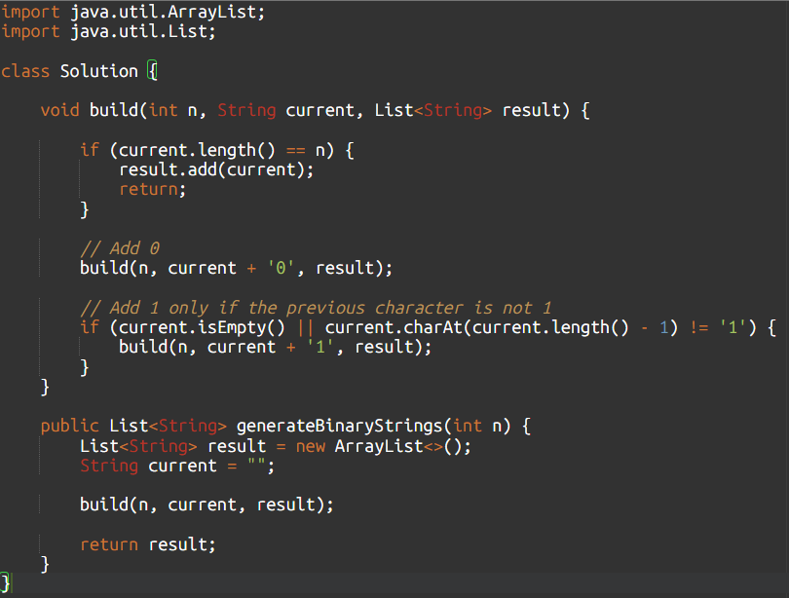
Infofys PYQ : psuedo codes
JAVA
CAMPUSMONK | EXPLANATION SPACE

Slide 10
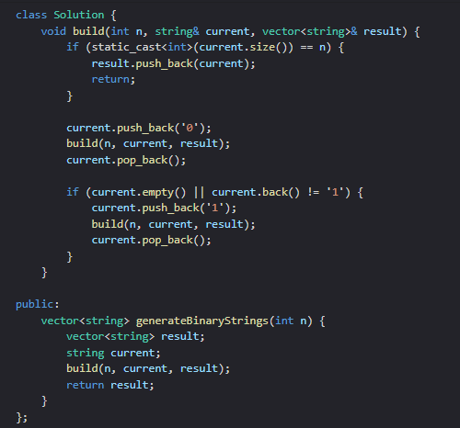
Infofys PYQ : psuedo codes
C++
CAMPUSMONK | EXPLANATION SPACE

